Slide 1

Large Scale Data Management Information Integration Project
Coluccelli Michele
1656336
A.Y. 2020/2021

Slide 2





Source Schema
IMDb (tsv)
TitleBasicsPrep(tconst, titleType, primaryTitle, originalTitle, isAdult, startYear, endYear, runtimeMinutes, genre)
NameBasics(nconst, primaryName, birthYear, deathYear, primaryProfession, knownForTitles)
TitleRatings(tconst, averageRating, numVotes)
TitlePrincipals(tconst, ordering, nconst, category, job, characters)
MovieLens (csv)
Movies(movieId, title, genres)
Links(movieId, imdbId, tmdbId)
RatingsPrep(userId, movieId, rating, timestamp)
Ruchi Kaggle (csv)
TvShowsRuchi(id, Title, Year, Age, IMDb, Rotten Tomatoes, Netflix, Hulu, Prime Video, Disney+)
MoviesRuchi(index, ID, Title, Year, Age, IMDb, Rotten_Tomatoes, Netflix, Hulu, Prime Video, Disney+, Type, Directors, Genres, Counry, Language, Runtime)
Oscar Kaggle (csv)
TheOscarAward(yearFilm, yearCeremony, ceremony, category, name, film, winner)
Emmy Kaggle (csv)
Emmy-awards-1949-2017(year, category, winner, nominee, detail)
As =
{TitleBasicsPrep_{/9,}NameBasics_{/6},TitleRatings_{/3},TitlePrincipals_{/6},
Movies_{/3},Links_{/3},RatingsPrep_{/4},
TvShowsRuchi_{/10}, MoviesRuchi_{/17}, TheOscarAward_{/7},Emmy_{/5}}

Slide 3







Pentaho

Slide 4
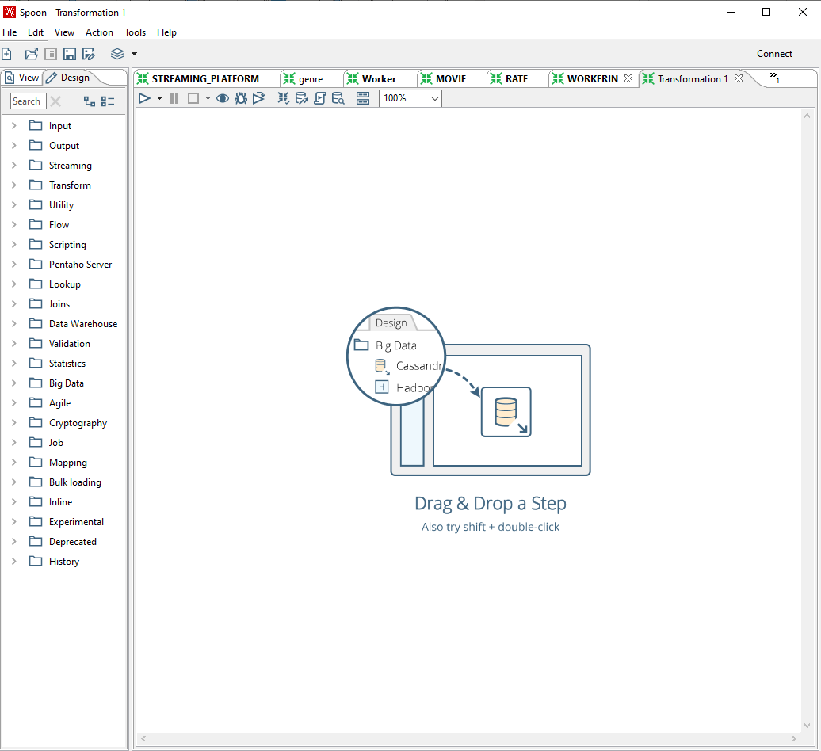
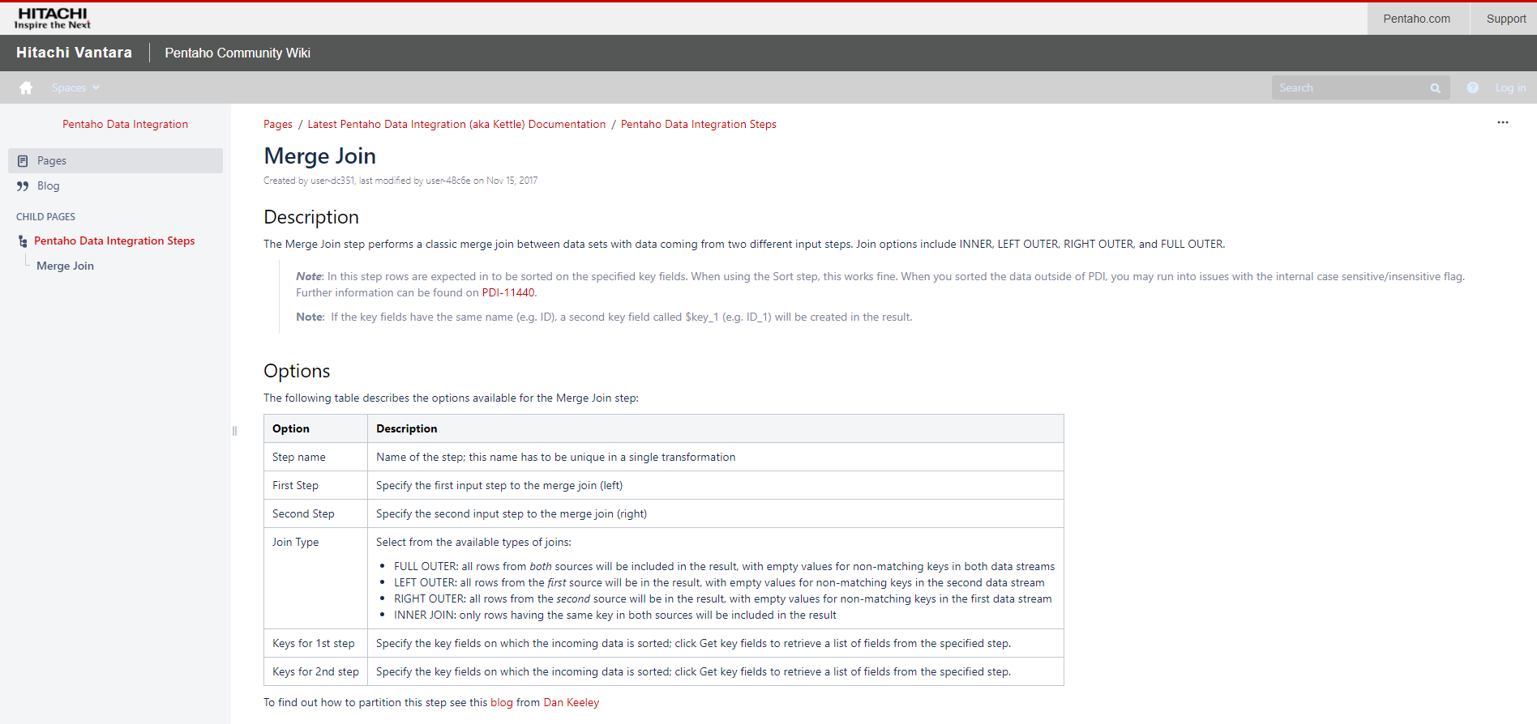
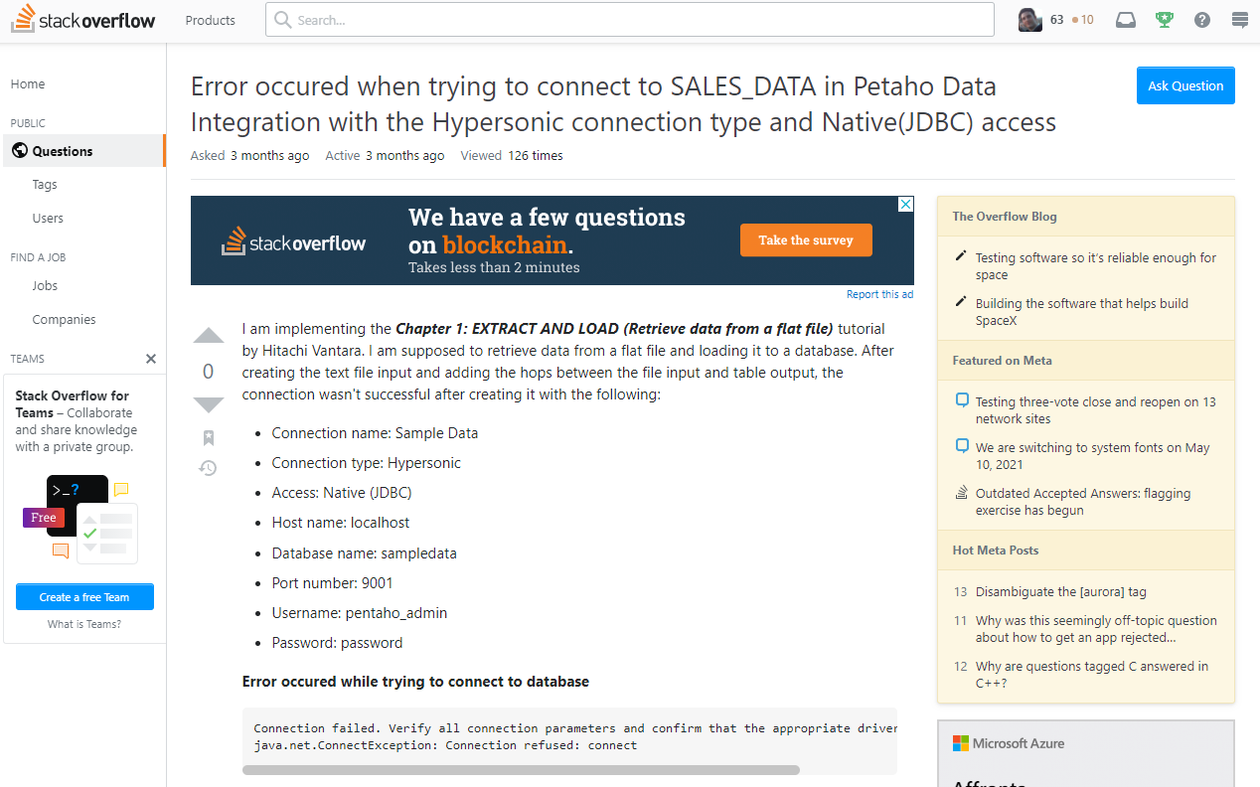

Pentaho – Opinions
- Intuitive user interface
- Rich documentation
- Many youtube tutorials
- Many forums on the web

Slide 5
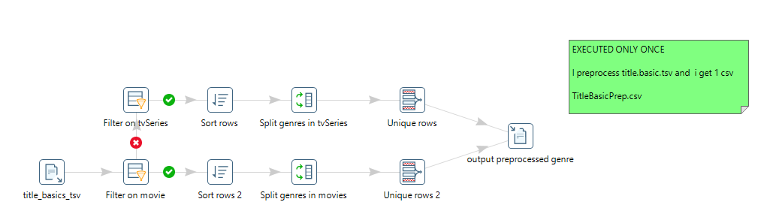
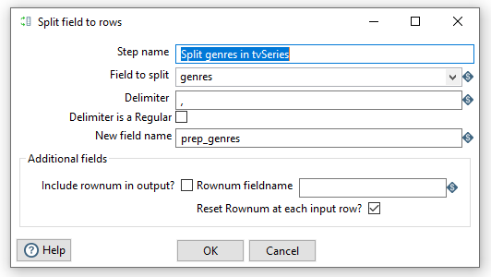
Preprocessing – TitleBasicPrep
Some files were not managable with FOL , so I decided to do two processing, still using Pentaho.
FOL cant manage String
For each video there can be more genres in set
{Action, Adult, Adventure, Animation, Biography, Comedy, Crime, Documentary, Drama, Family, Fantasy, Film-Noir, Game-Show, History, Horror, Music, Musical, Mystery, News, Reality-TV, Romance, Sci-Fi, Short, Sport,Talk-Show, Thriller, War, Western}
For each film there will be a row for each genre

Slide 6

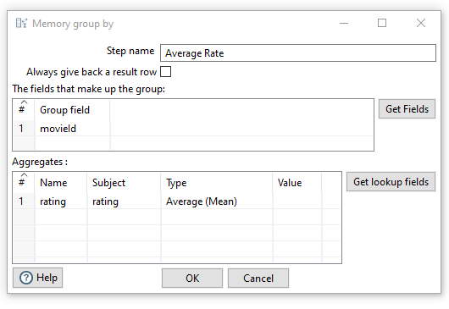
Preprocessing - RatingsPrep
For each film there can be n users voting for it
In the preprocessed one i compute the average of the rate receveid by a given movie identified by movied

Slide 7
Global Schema - no axioms
hasGenre(id, title, genre)
VideoProduct(imdbid, titletype, primarytitle, startyear, endyear)
Oscar(candidate, category, film, year_film, year_ceremony, ceremony, winner )
Emmy(nominee, year, category, winner, detail)
Platform(title, netflix, hulu, PrimeVideo, DisneyPlus)
rateIMDB(title, average, numvotes)
rateMovieLens(title, rating)
Worker(nconst, primaryname, birthyear, deathyear, work)
- WorkerIn(name, title)
Ag = {hasGenre_{/3}, VideoProduct_{/5}, Oscar_{/7}, Emmy_{/5}, Platform_{/5}, rateIMDB_{/3}, rateMovieLens_{/2},Worker_{/5},WorkerIn_{/2}}

Slide 8
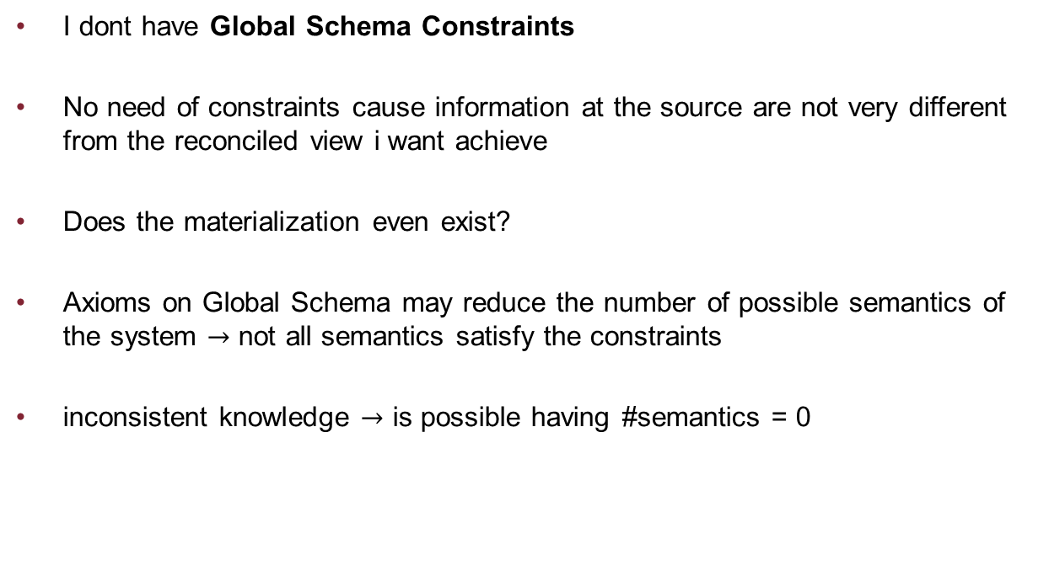
Global Schema - no axioms
I dont have Global Schema Constraints
No need of constraints cause information at the source are not very different from the reconciled view i want achieve
Does the materialization even exist?
Axioms on Global Schema may reduce the number of possible semantics of the system $→$ not all semantics satisfy the constraints
inconsistent knowledge $→$ is possible having #semantics = 0

Slide 9
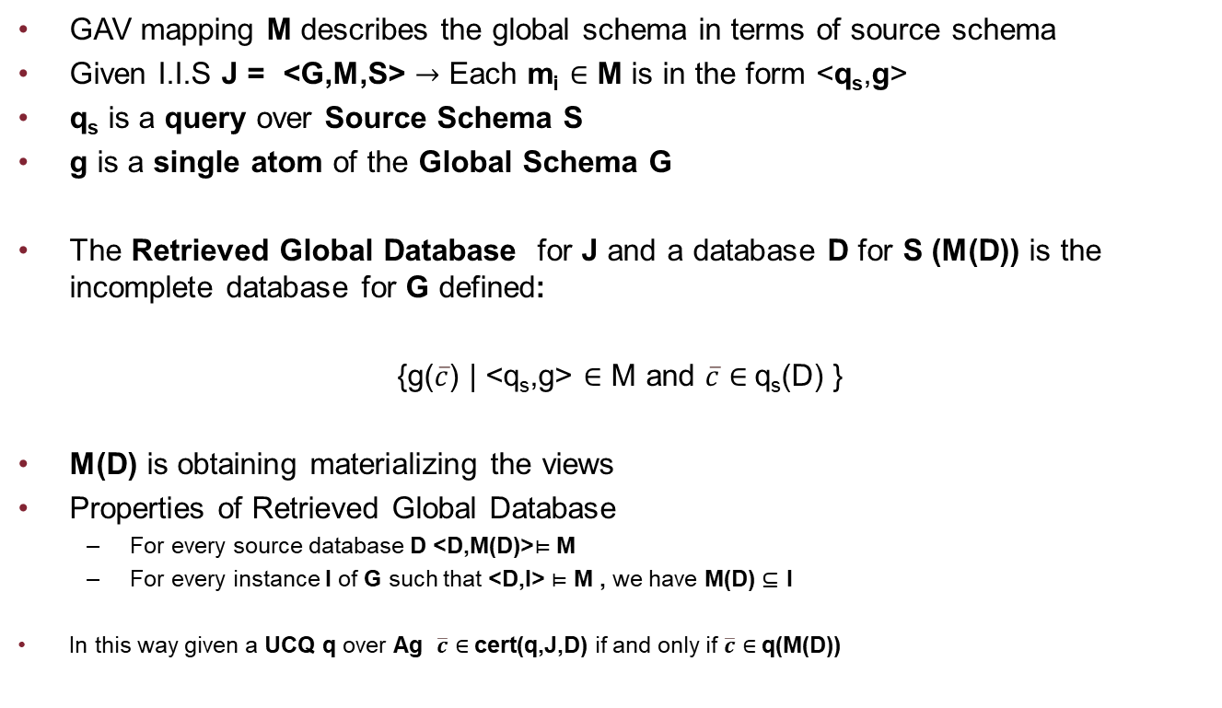
GAV Mapping – Materialization Approach
GAV mapping M describes the global schema in terms of source schema
Given I.I.S J = <G,M,S> $→$ Each m_{i} $∈$ M is in the form <q_{s},g>
q_{s} is a query over Source Schema S
g is a single atom of the Global Schema G
The Retrieved Global Database for J and a database D for S (M(D)) is the incomplete database for G defined:
{g($\overline{c}$) | <q_{s},g> $∈$ M and $\overline{c}$ $∈$q_{s}(D) }
M(D) is obtaining materializing the views
Properties of Retrieved Global Database
For every source database D <D,M(D)>$⊨$ M
For every instance I of G such that <D,I> $⊨$ M , we have M(D) $⊆$ I
In this way given a UCQ q over Ag $\overline{c}$ $∈$cert(q,J,D) if and only if $\overline{c}$ $∈$q(M(D))

Slide 10
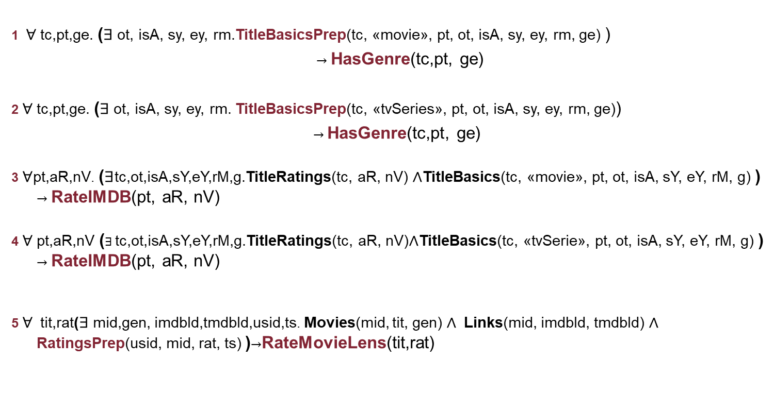
GAV Mapping – Materialization Approach
1 $∀$tc,pt,ge. ($∃$ot, isA, sy, ey, rm.TitleBasicsPrep(tc, «movie», pt, ot, isA, sy, ey, rm, ge) )
$→$ HasGenre(tc,pt, ge)
2 $∀$tc,pt,ge. ($∃$ot, isA, sy, ey, rm. TitleBasicsPrep(tc, «tvSeries», pt, ot, isA, sy, ey, rm, ge))
$→$ HasGenre(tc,pt, ge)
3 $∀$pt,aR,nV. ($∃$tc,ot,isA,sY,eY,rM,g.TitleRatings(tc, aR, nV) $∧$TitleBasics(tc, «movie», pt, ot, isA, sY, eY, rM, g) ) $→$ RateIMDB(pt, aR, nV)
4 $∀$pt,aR,nV ($∃$tc,ot,isA,sY,eY,rM,g.TitleRatings(tc, aR, nV)$∧$TitleBasics(tc, «tvSerie», pt, ot, isA, sY, eY, rM, g) ) $→$ RateIMDB(pt, aR, nV)
5 $∀$ tit,rat($∃$mid,gen, imdbId,tmdbId,usid,ts. Movies(mid, tit, gen) $∧$ Links(mid, imdbId, tmdbId) $∧$ RatingsPrep(usid, mid, rat, ts) )$→$RateMovieLens(tit,rat)

Slide 11
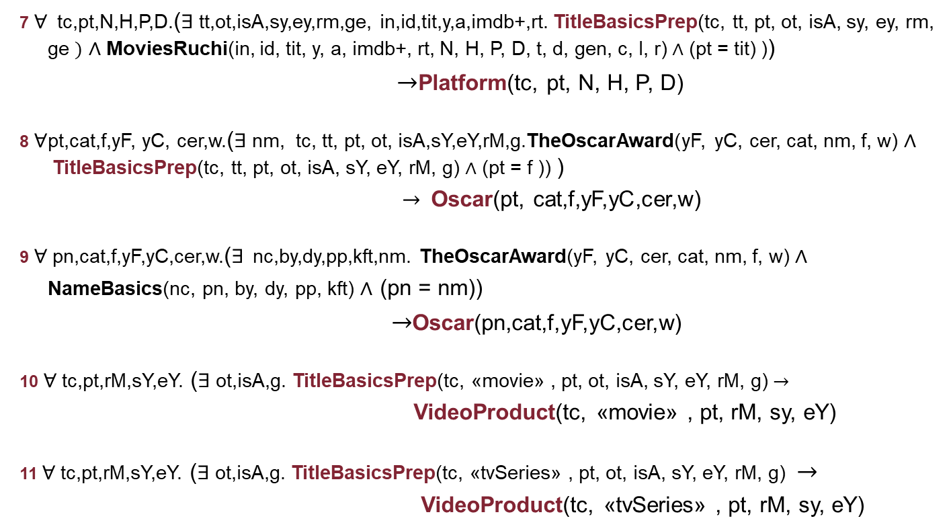
GAV Mapping – Materialization Approach
7 $∀$tc,pt,N,H,P,D.($∃$tt,ot,isA,sy,ey,rm,ge, in,id,tit,y,a,imdb+,rt. TitleBasicsPrep(tc, tt, pt, ot, isA, sy, ey, rm, ge $)$ $∧$MoviesRuchi(in, id, tit, y, a, imdb+, rt, N, H, P, D, t, d, gen, c, l, r) $∧$ (pt = tit) ))
$→$Platform(tc, pt, N, H, P, D)
8 $∀$pt,cat,f,yF, yC, cer,w.($∃$nm, tc, tt, pt, ot, isA,sY,eY,rM,g.TheOscarAward(yF, yC, cer, cat, nm, f, w) $∧$TitleBasicsPrep(tc, tt, pt, ot, isA, sY, eY, rM, g) $∧$ (pt = f )) )
$→$Oscar(pt, cat,f,yF,yC,cer,w)
9 $∀$ pn,cat,f,yF,yC,cer,w.($∃$ nc,by,dy,pp,kft,nm. TheOscarAward(yF, yC, cer, cat, nm, f, w) $∧$
NameBasics(nc, pn, by, dy, pp, kft) $∧$ (pn = nm))
$→$Oscar(pn,cat,f,yF,yC,cer,w)
10 $∀$tc,pt,rM,sY,eY. ($∃$ ot,isA,g. TitleBasicsPrep(tc, «movie» , pt, ot, isA, sY, eY, rM, g)$→$
VideoProduct(tc, «movie» , pt, rM, sy, eY)
11 $∀$tc,pt,rM,sY,eY. ($∃$ot,isA,g. TitleBasicsPrep(tc, «tvSeries» , pt, ot, isA, sY, eY, rM, g) $→$
VideoProduct(tc, «tvSeries» , pt, rM, sy, eY)

Slide 12
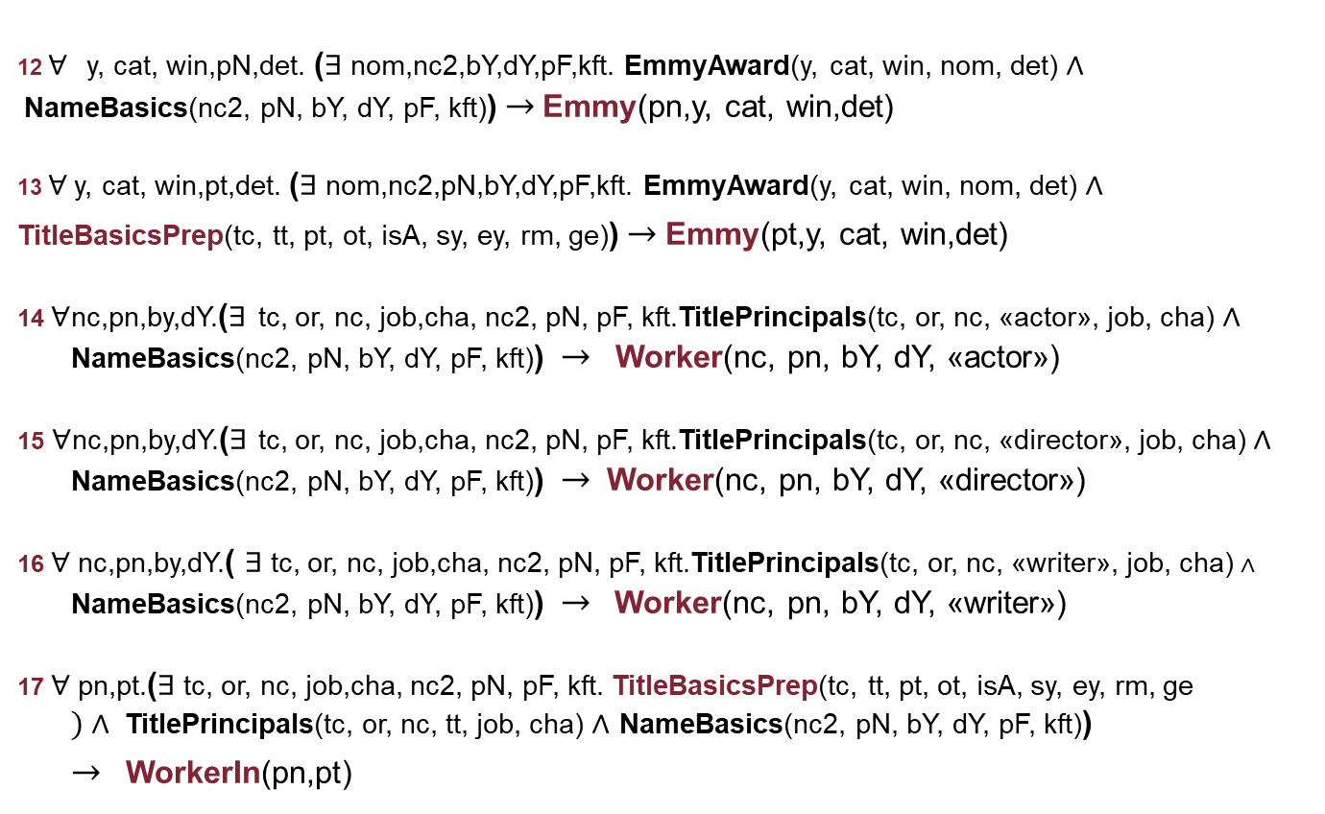
GAV Mapping – Materialization Approach
12 $∀$ y, cat, win,pN,det. ($∃$nom,nc2,bY,dY,pF,kft. EmmyAward(y, cat, win, nom, det) $∧$NameBasics(nc2, pN, bY, dY, pF, kft))$→$ Emmy(pn,y, cat, win,det)
13 $∀$ y, cat, win,pt,det. ($∃$nom,nc2,pN,bY,dY,pF,kft. EmmyAward(y, cat, win, nom, det) $∧$
TitleBasicsPrep(tc, tt, pt, ot, isA, sy, ey, rm, ge))$→$Emmy(pt,y, cat, win,det)
14 $∀$nc,pn,by,dY.($∃$ tc, or, nc, job,cha, nc2, pN, pF, kft.TitlePrincipals(tc, or, nc, «actor», job, cha) $∧$ NameBasics(nc2, pN, bY, dY, pF, kft)) $→$Worker(nc, pn, bY, dY, «actor»)
15 $∀$nc,pn,by,dY.($∃$ tc, or, nc, job,cha, nc2, pN, pF, kft.TitlePrincipals(tc, or, nc, «director», job, cha) $∧$ NameBasics(nc2, pN, bY, dY, pF, kft)) $→$Worker(nc, pn, bY, dY, «director»)
16 $∀$ nc,pn,by,dY.( $∃$tc, or, nc, job,cha, nc2, pN, pF, kft.TitlePrincipals(tc, or, nc, «writer», job, cha) $∧$ NameBasics(nc2, pN, bY, dY, pF, kft))$→$Worker(nc, pn, bY, dY, «writer»)
17 $∀$ pn,pt.($∃$tc, or, nc, job,cha, nc2, pN, pF, kft. TitleBasicsPrep(tc, tt, pt, ot, isA, sy, ey, rm, ge $)∧$TitlePrincipals(tc, or, nc, tt, job, cha) $∧$ NameBasics(nc2, pN, bY, dY, pF, kft))
$→$WorkerIn(pn,pt)

Slide 13
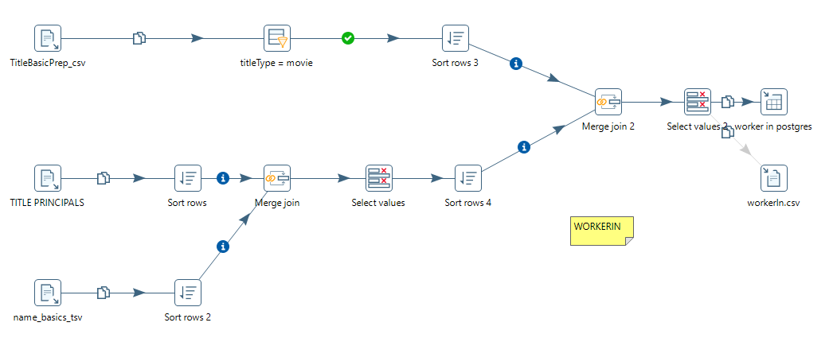
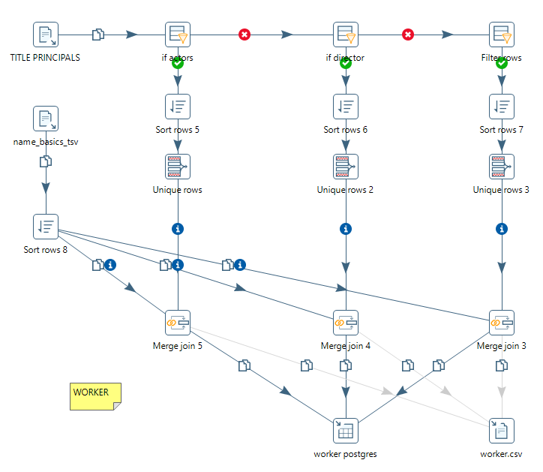
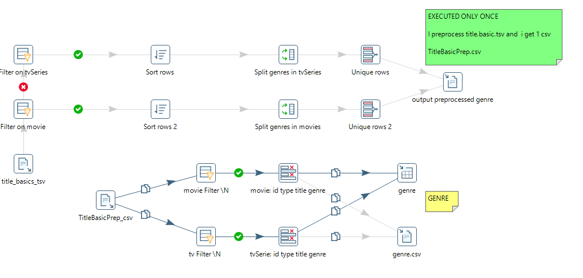
Mapping in Pentaho

Slide 14
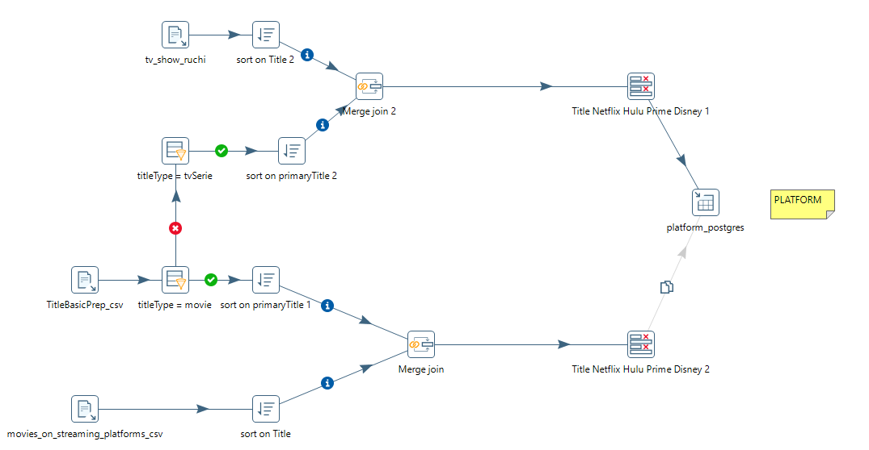
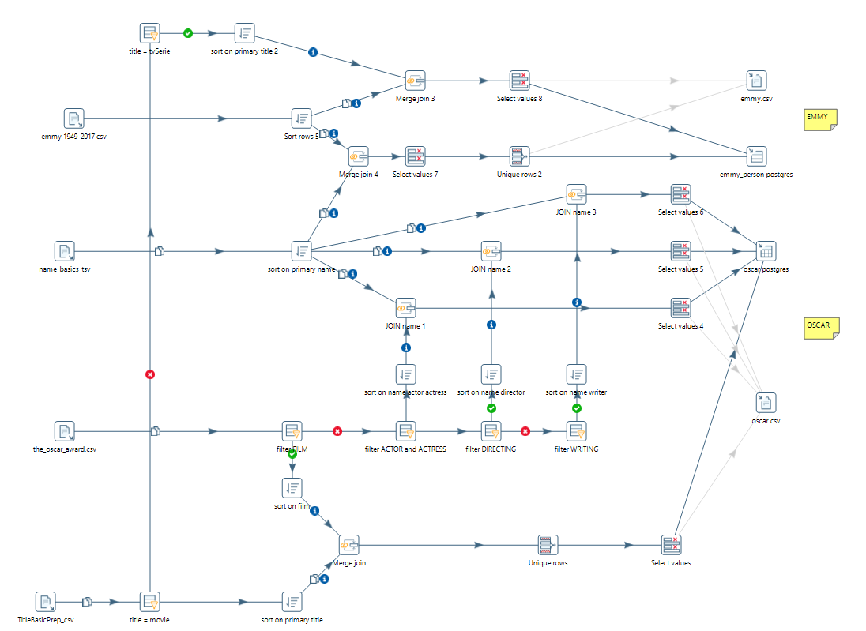
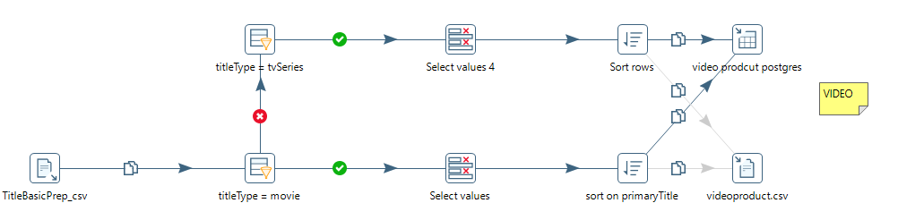
Mapping in Pentaho

Slide 15
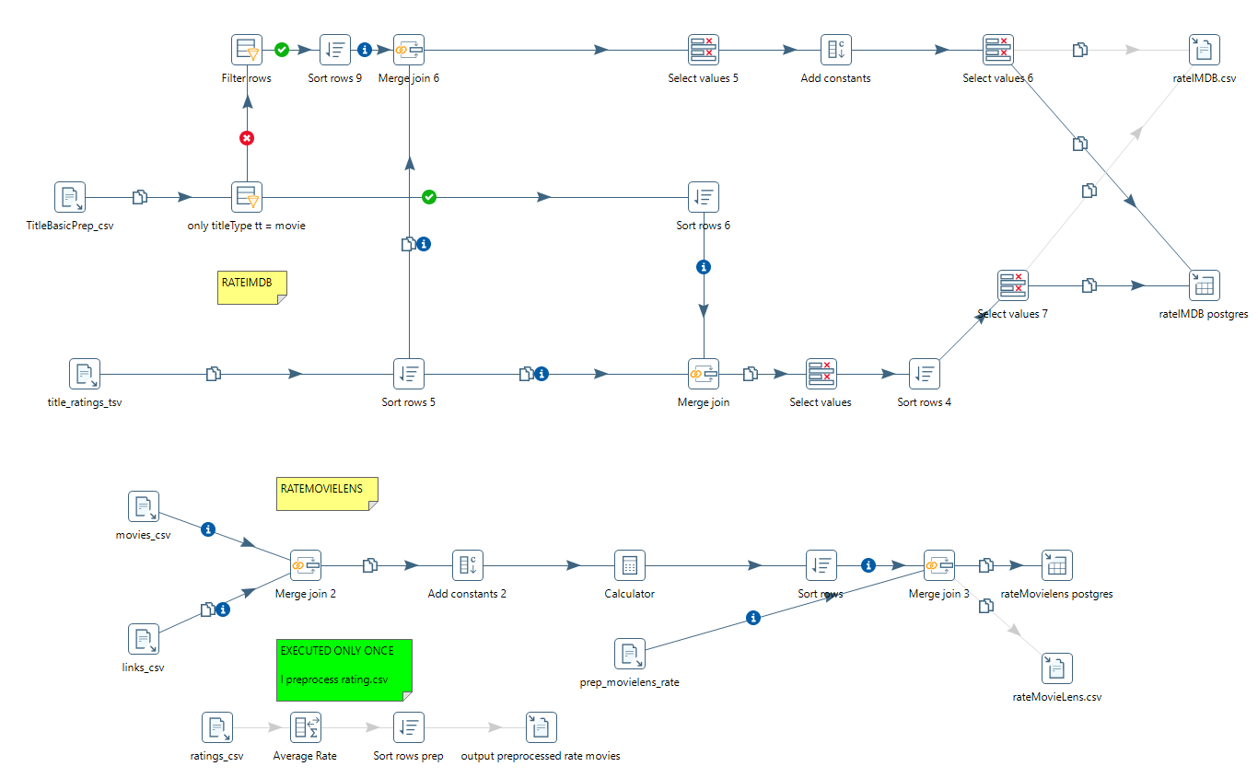
Mapping in Pentaho

Slide 16
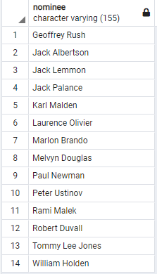
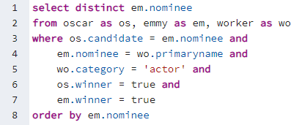
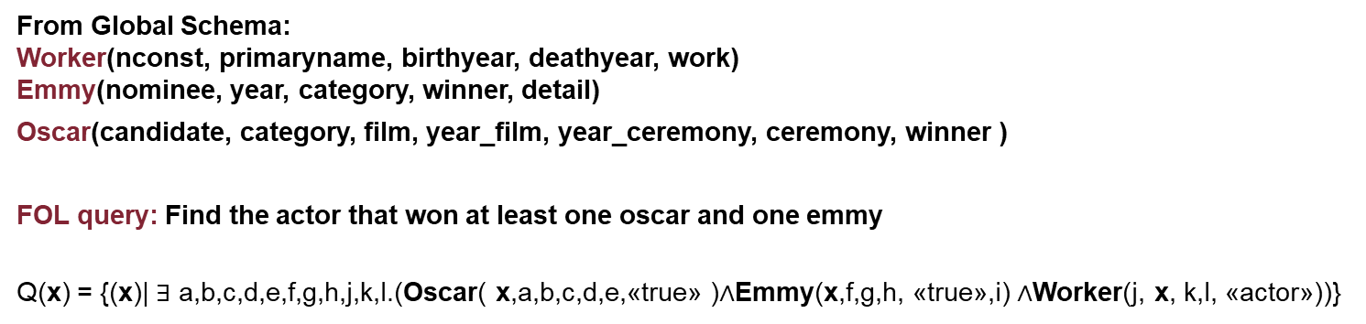
Queries on Retrieved Global Database
From Global Schema:
Worker(nconst, primaryname, birthyear, deathyear, work)
Emmy(nominee, year, category, winner, detail)
Oscar(candidate, category, film, year_film, year_ceremony, ceremony, winner )
FOL query: Find the actor that won at least one oscar and one emmy
Q(x) = {(x)| $∃$ a,b,c,d,e,f,g,h,j,k,l.(Oscar( x,a,b,c,d,e,«true» )$∧$Emmy(x,f,g,h, «true»,i) $∧$Worker(j, x, k,l, «actor»))}

Slide 17
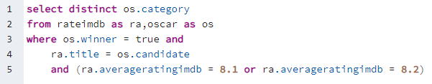
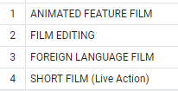
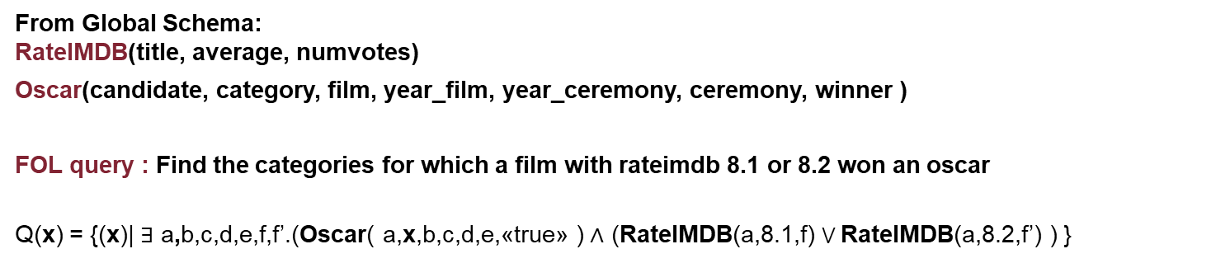
Queries on Retrieved Global Database
From Global Schema:
RateIMDB(title, average, numvotes)
Oscar(candidate, category, film, year_film, year_ceremony, ceremony, winner )
FOL query : Find the categories for which a film with rateimdb 8.1 or 8.2 won an oscar
Q(x) = {(x)| $∃$ a,b,c,d,e,f,f’.(Oscar( a,x,b,c,d,e,«true» ) $∧$ (RateIMDB(a,8.1,f) ⋁ RateIMDB(a,8.2,f’) ) }

Slide 18
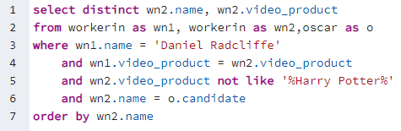

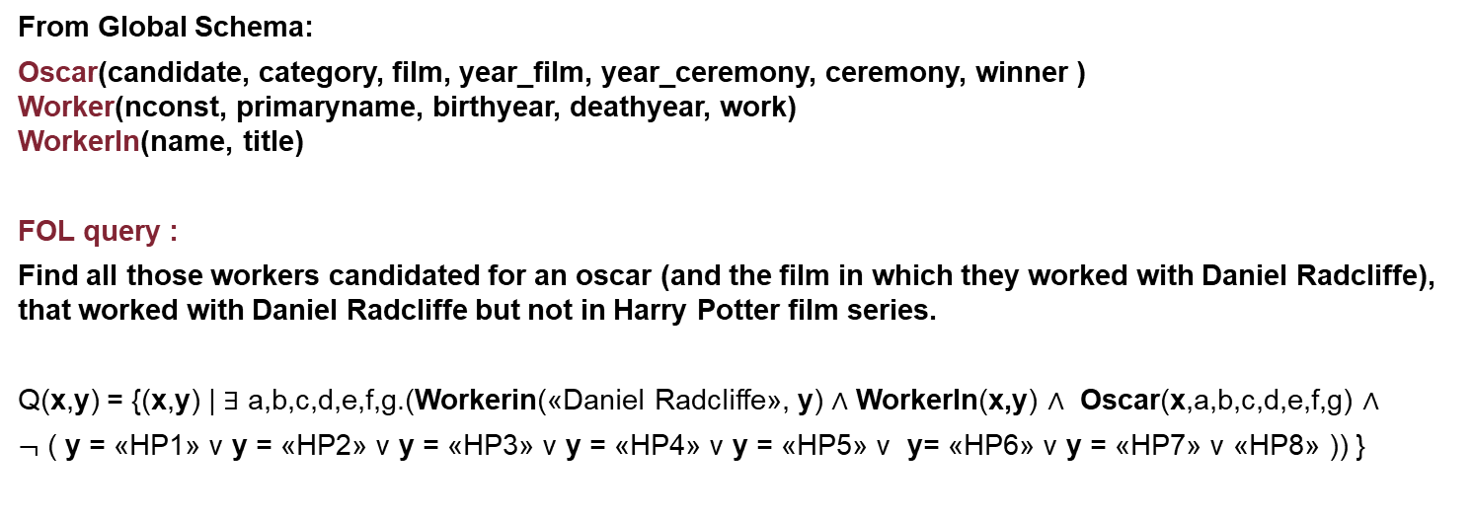
Queries on Retrieved Global Database
From Global Schema:
Oscar(candidate, category, film, year_film, year_ceremony, ceremony, winner )
Worker(nconst, primaryname, birthyear, deathyear, work)
WorkerIn(name, title)
FOL query :
Find all those workers candidated for an oscar (and the film in which they worked with Daniel Radcliffe), that worked with Daniel Radcliffe but not in Harry Potter film series.
Q( n2, vp2,win) =
Q(x,y) = {(x,y) | $∃$ a,b,c,d,e,f,g.(Workerin(«Daniel Radcliffe», y) $∧$ WorkerIn(x,y) $∧$ Oscar(x,a,b,c,d,e,f,g) $∧$
$¬$ ( y = «HP1» v y = «HP2» v y = «HP3» v y = «HP4» v y = «HP5» v y= «HP6» v y = «HP7» v «HP8» )) }

Slide 19
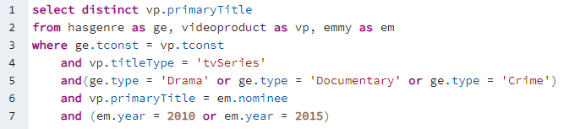
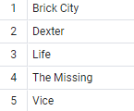
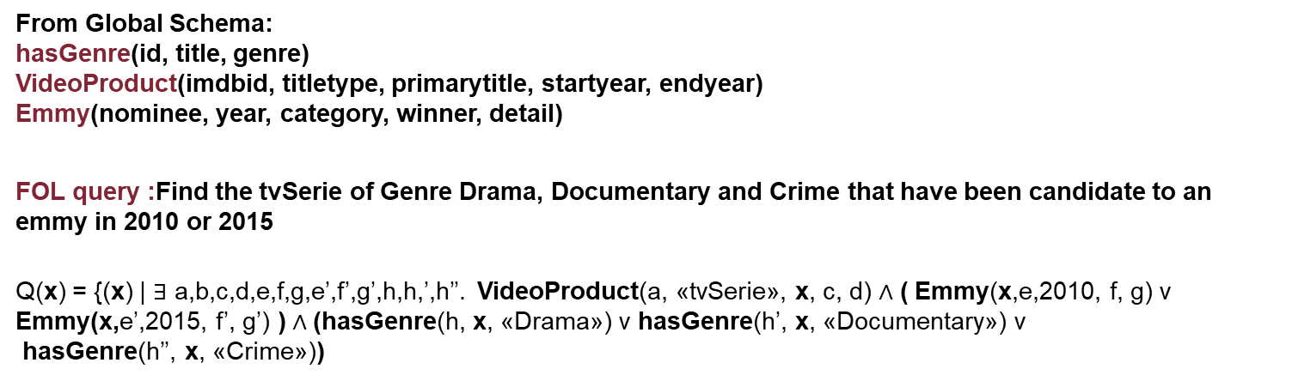
Queries on Retrieved Global Database
From Global Schema:
hasGenre(id, title, genre)
VideoProduct(imdbid, titletype, primarytitle, startyear, endyear)
Emmy(nominee, year, category, winner, detail)
FOL query :Find the tvSerie of Genre Drama, Documentary and Crime that have been candidate to an emmy in 2010 or 2015 vp2,win) =
Q(x) = {(x) | $∃$ a,b,c,d,e,f,g,e’,f’,g’,h,h,’,h’’. VideoProduct(a, «tvSerie», x, c, d) $∧$ ( Emmy(x,e,2010, f, g) v Emmy(x,e’,2015, f’, g’) ) $∧$(hasGenre(h, x, «Drama») v hasGenre(h’, x, «Documentary») v
hasGenre(h’’, x, «Crime»))

Slide 20
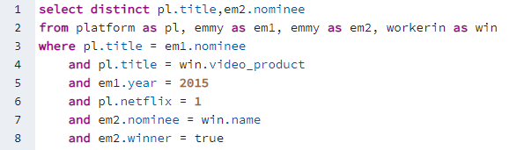

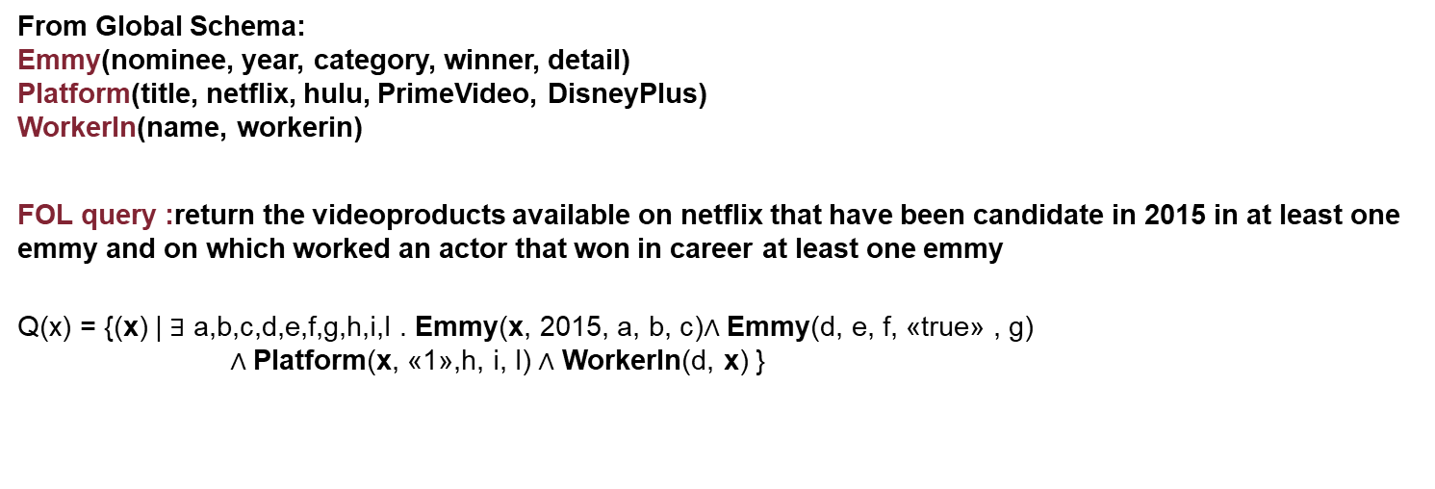
Queries on Retrieved Global Database
From Global Schema:
Emmy(nominee, year, category, winner, detail)
Platform(title, netflix, hulu, PrimeVideo, DisneyPlus)
WorkerIn(name, workerin)
FOL query :return the videoproducts available on netflix that have been candidate in 2015 in at least one emmy and on which worked an actor that won in career at least one emmy
Q(x) = {(x) | $∃$ a,b,c,d,e,f,g,h,i,l . Emmy(x, 2015, a, b, c)$∧$ Emmy(d, e, f, «true» , g)
$∧$Platform(x, «1»,h, i, l) $∧$ WorkerIn(d, x) }

Slide 21
References
Pentaho Documentations: https://help.pentaho.com/Documentation/9.1
IMDb Dataset: https://www.imdb.com/interfaces/
MovieLens Dataset: https://grouplens.org/datasets/movielens/
tvShow Ruchi: https://www.kaggle.com/ruchi798/tv-shows-on-netflix-prime-video-hulu-and-disney
Movie Ruchi: https://www.kaggle.com/ruchi798/movies-on-netflix-prime-video-hulu-and-disney
Emmy Awards 1949-2017: https://www.kaggle.com/pmagda/primetime-emmy-awards
The Oscar Award 1927-2020: https://www.kaggle.com/unanimad/the-oscar-award

